Slide 1


Project Delivery and Contract Strategies
Prof. Steve W. Bannes
Director, Graduate Studies in Construction Management
School of Engineering & Applied Science
Washington University in St. Louis
25 March 2015
A Program Presented Jointly by:
SLCCC – St. Louis Council of Construction Consumers
DBIA – Design-Build Institute of America – St. Louis Chapter

Slide 2
Industry Reality Check
Have you ever been on a project that went completely sideways?
Was it the other guy’s fault?
Were you slightly, slightly, slightly to blame?
Could the project have been planned, set up, and contracted in such a way to improve the project’s outcomes?

Slide 3
Project Delivery Method
An approach used to organize a project team so as to manage the delivery of a project.

Slide 4
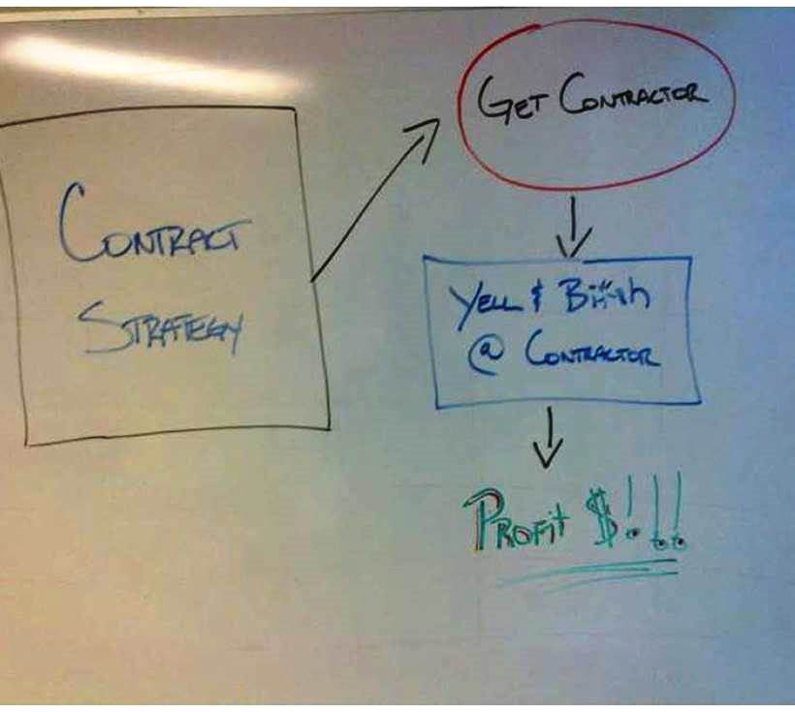
One
Perspective . . .

Slide 5
Project Delivery Method
  A term describing the comprehensive design and construction processes, including all the:
  procedures,
  actions,
  sequences of events,
  contractual relations,
  obligations,
  interrelations, and
  various forms of agreement
  all aimed at successful completion of the design and construction of facilities.

Slide 6
Project Delivery Method
It is NOT a purchasing decision!
  Commodity – assumes equality
  Price driven – if all are equal . . .

Slide 7
Project Delivery Method
It is a Project Execution Strategy!

Slide 8
Project Delivery and Contract Strategy (PDCS)
A structured process of evaluating and prioritizing owner’s objectives, reviewing and evaluating delivery methods and contract types, and then determining what is the appropriate delivery method and contract type for the project.

Slide 9
Barriers to effective PDCS
Status quo
We think (or assume) we understand
  Goals
  Objectives
  Key success factors
  Project execution strategy
  Capabilities of the contractor supply market
  Scope of work and interfaces
  Roles and responsibilities
  Risks and mitigation strategies
May require comprehensive change, including significant modifications to both the work processes and the existing organizational structure

Slide 10
Bannes’ Matrix
A simplified PDCS
A measure of Risk Allocation

Slide 11
Project Delivery Method Variables
Contract Philosophy/Strategy
Constructor Selection Criteria
Contract Type

Slide 12
A. Contract Philosophy/Strategy
Single total responsibility – vs. – many individuals
Range of systems: (from single to multiple)
  Turnkey
  Design/build/manage/lease
  Design/build/sell
  Team concept AE/CM–R
  Traditional GC
  GC and mechanical/electrical primes
  Pure professional CM–A
  Multiple trade and service contracts - Owner as GC

Slide 13
B. Constructor Selection Criteria
Unqualified - numerous contractors
Prequalified – select/limited - responsible
Range of selection criteria (from value to price)
  Special qualifications - unique- selected
    Qualification Based Selection (QBS)
  Presentation data/interviews
  Fee formulas + qualification data
  Bidding from prequalified list
  Open bidding ("guts or nuts")

Slide 14
C. Contract Type
Service (agency)
Vendor (adversary)
Range of types/risks (from service to vendor)
  Professional service agreement
  Fixed or % fee
  Incentive "split" savings
  Guaranteed maximum with mutual formula
  Allowances; contingencies
  Unit cost
  Negotiated lump sum cost
  Firm competitive bid lump sum cost
    Strictly per plans and specs

Slide 15
B. Contractor Selection Criteria
C. Contract Type
A. Contract Philosophy/Strategy
Delivery System Variables

Slide 16
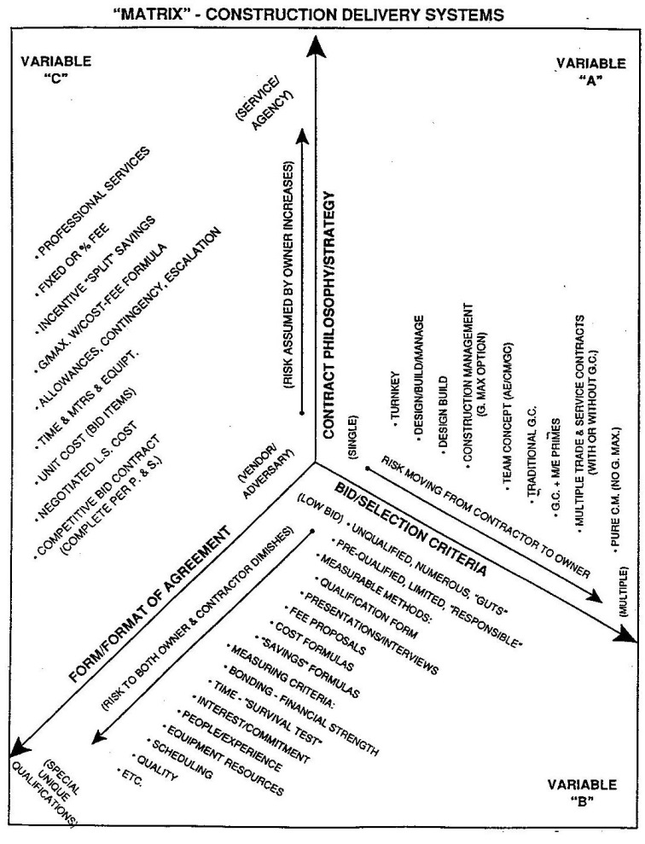

Slide 17
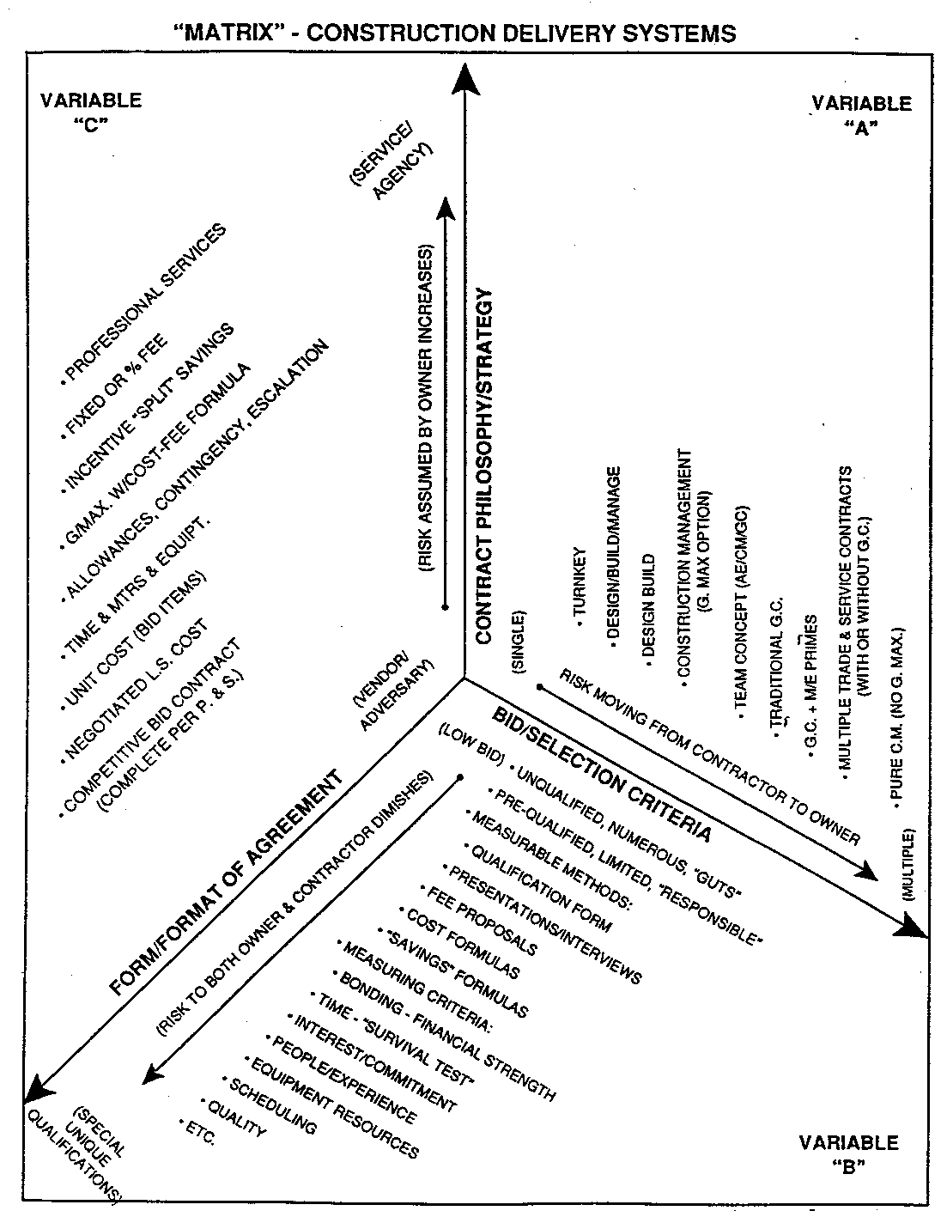
Delivery Method Risk Analysis
Traditional Delivery System

Slide 18
CII Implementation Resource 165-2
A Tool for Owners

Slide 19
Project Delivery and Contract Strategy Selection Process Flowchart

Slide 22
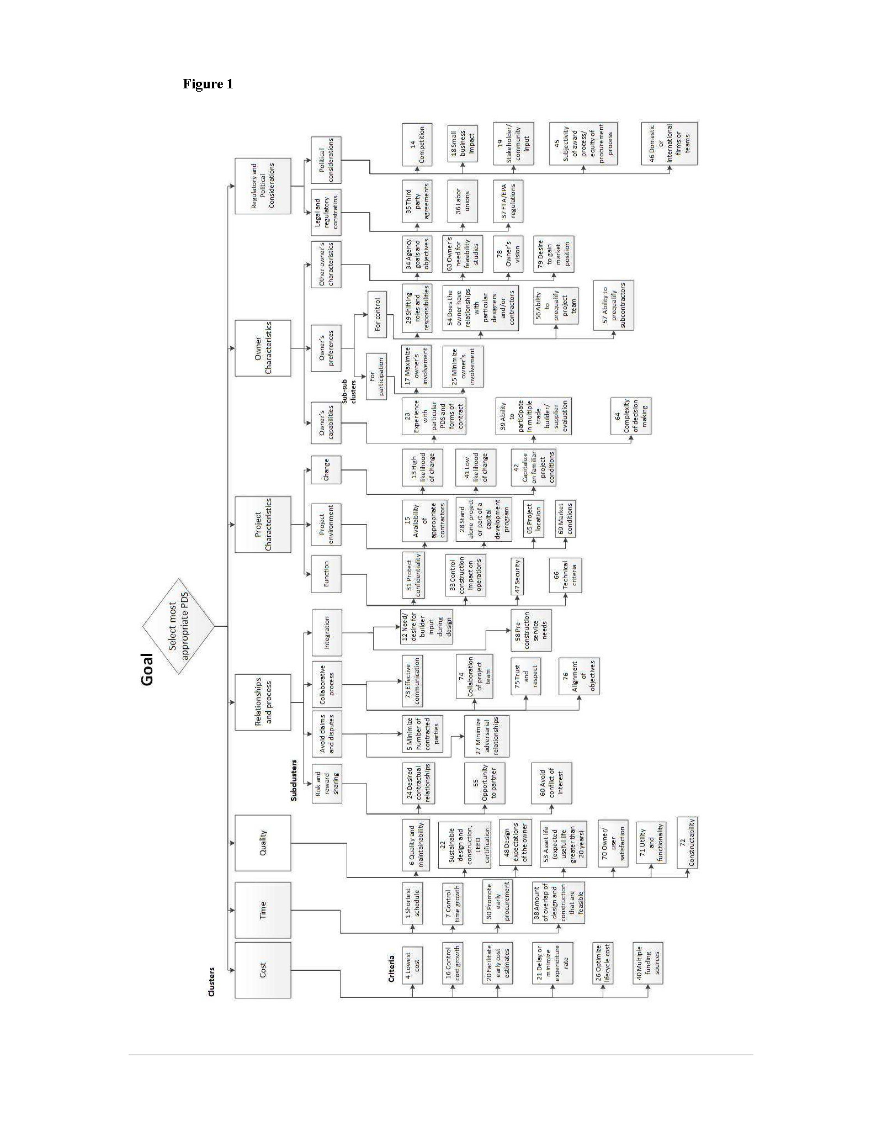
MULTI-TIERED PROJECT DELIVERY SYSTEMS SELECTION FOR CAPITAL PROJECTS
O. Moselhi, P. E., Ph. D. and *Z. Popic

Slide 23
Thank You!
To stay on schedule, I will be happy to take questions at the end of the program.
This material is copyrighted © by Bannes Development Strategies and the author – Steve W. Bannes who retains all rights to the material. No part of this presentation may be reproduced by any means or methods without the explicit written permission of the author. CII and other copyrighted materials are included and used with permission.

